Slide 1

CAPSTONE PROJECT 4
Amazon top 50 best selling books 2009 – 2019 12apr2021

Slide 2



objectives
To predict the number of books which are fiction & non-fiction

Slide 3
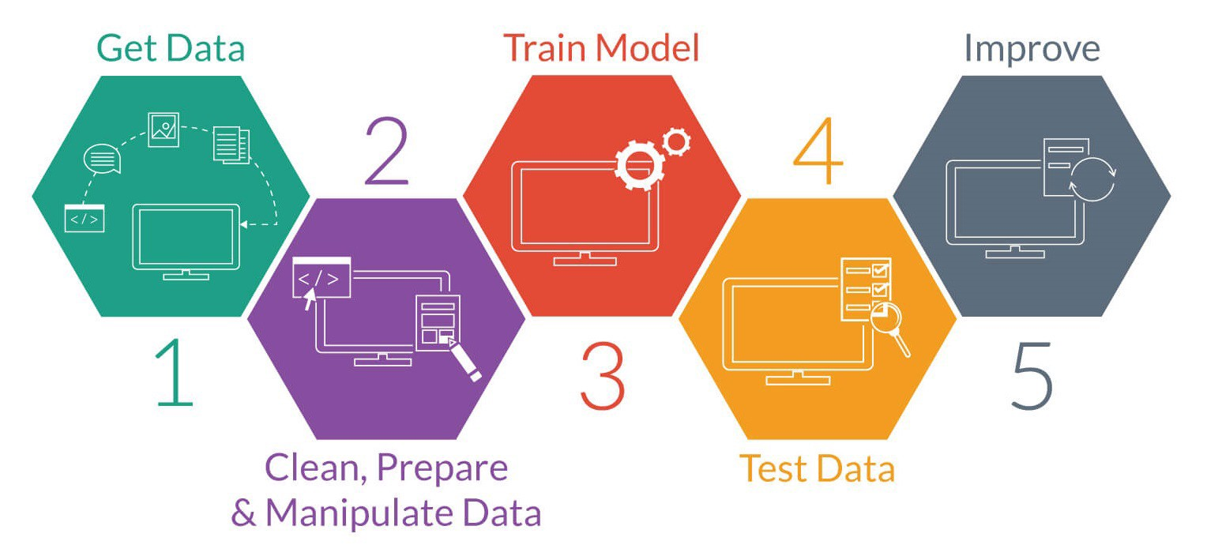
workflow

Slide 4
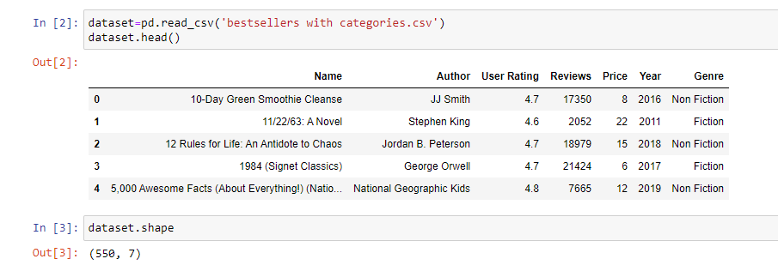
Task 1
DATA COLLECTION
Datasets:- https://www.kaggle.com/sootersaalu/amazon-top-50-bestselling-books-2009-2019
Consists of 550 rows & 7 columns
Independent variables
Name
Author
User Rating
Reviews
Price
Year
Dependent variable
Genre

Slide 5
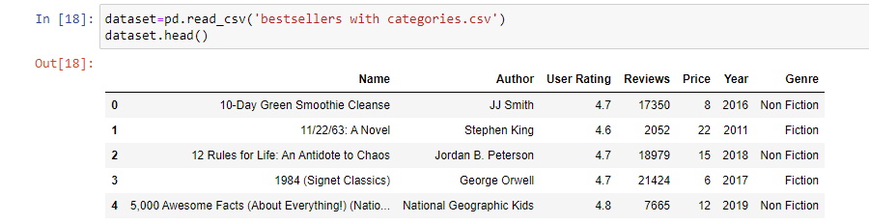
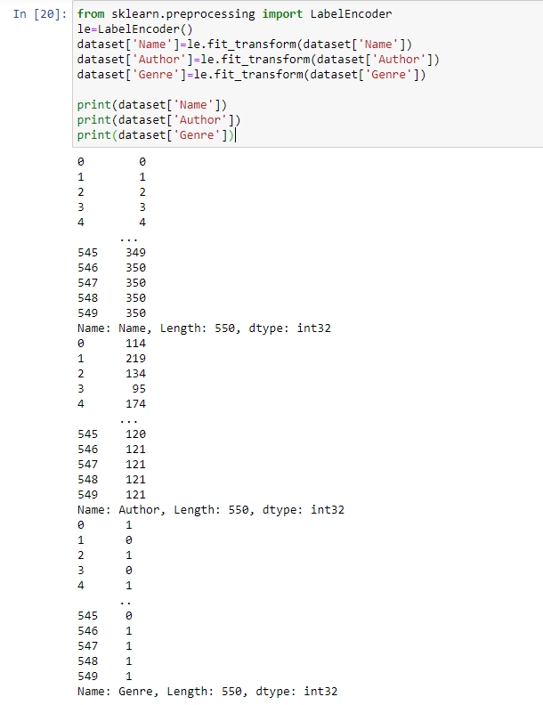
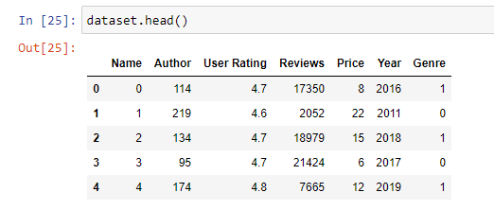
Task 2
DATA PREPARATION
Data Cleaning
Data Transformation
Feature Engineering
Data has no Null values.
Found 3 Categorical data(Name, Author, Genre) which needs to be converted into numerical by using Label Encoder.

Slide 6

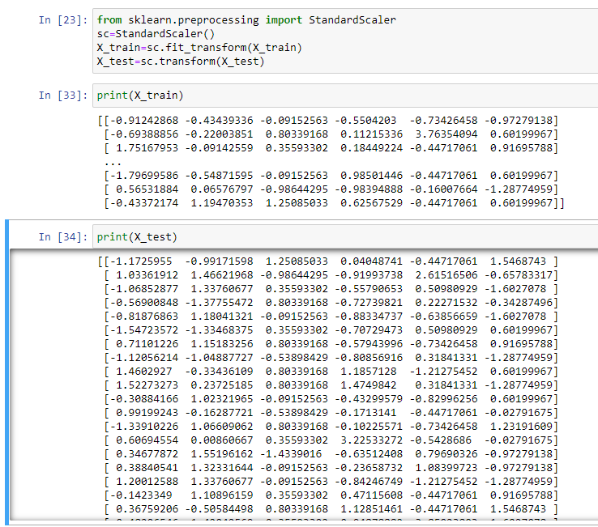
Task 2
DATA PREPARATION
Defining X as Independent variables and y as dependent variable
Using Feature Scaling method to convert the input array into normalize array
X_train → will transform into normalize array & fits into the model.
X_test → only transform into normalize array.

Slide 7
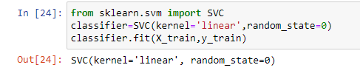

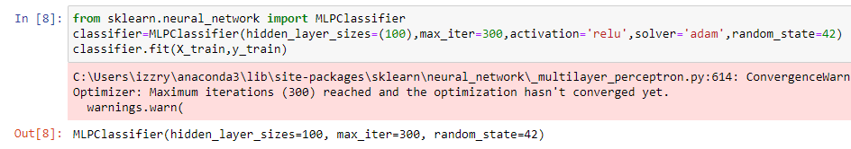
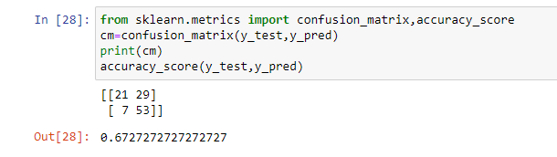
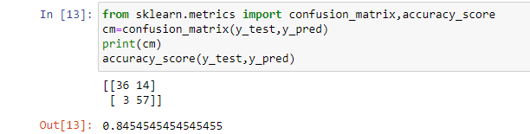
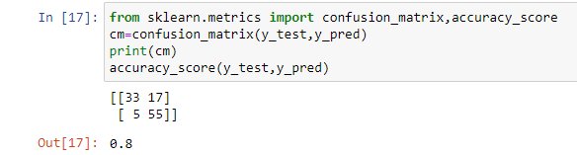
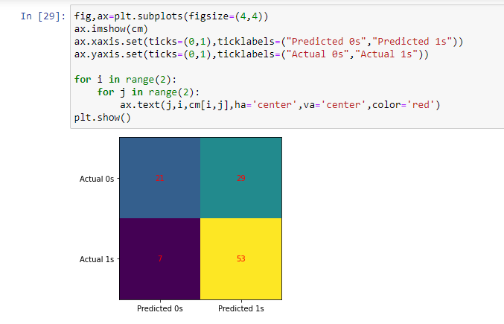
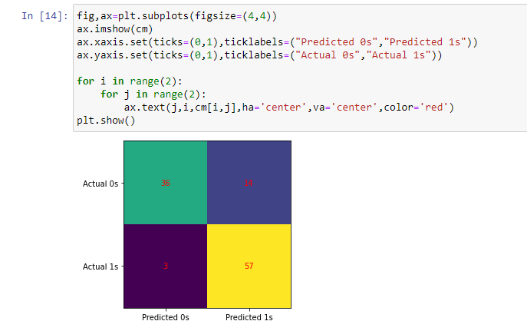
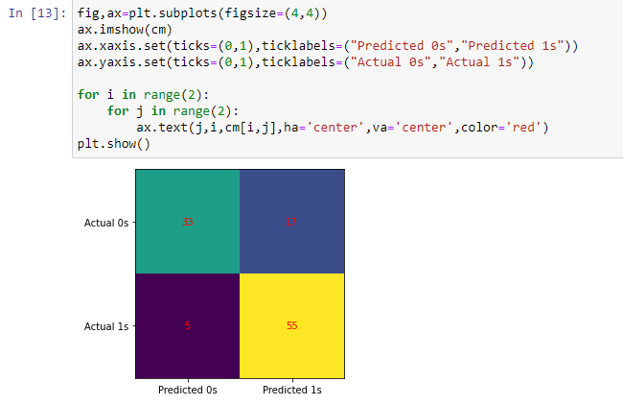
Task 3
MODEL SELECTION
SVM – Support Vector Machine
Random Forest
MLP – Multi Layer Perceptron
SVM
RANDOM FOREST
MLP
Accuracy of 67% False positive (29%) False negative (7%) | Accuracy of 84% False positive (14%) False negative (3%) | Accuracy of 80% False positive (17%) False negative (5%)

Slide 8
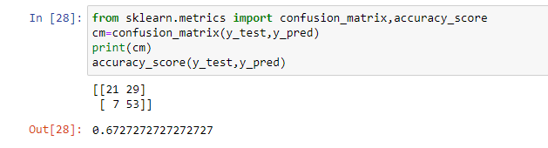
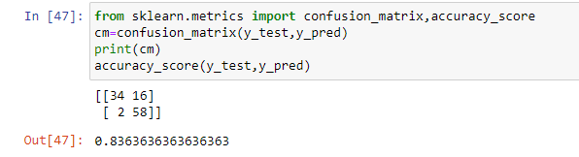
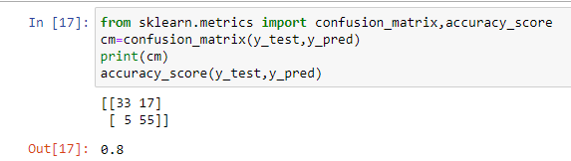
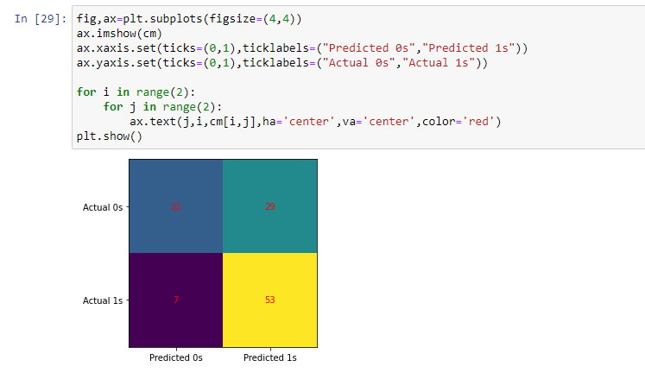
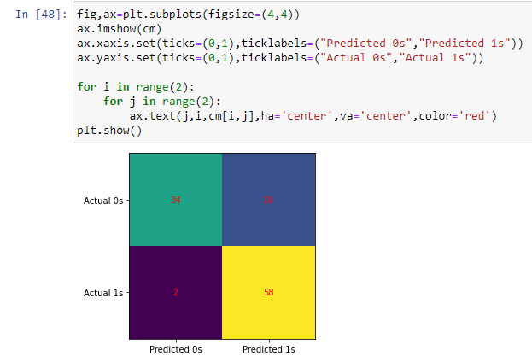
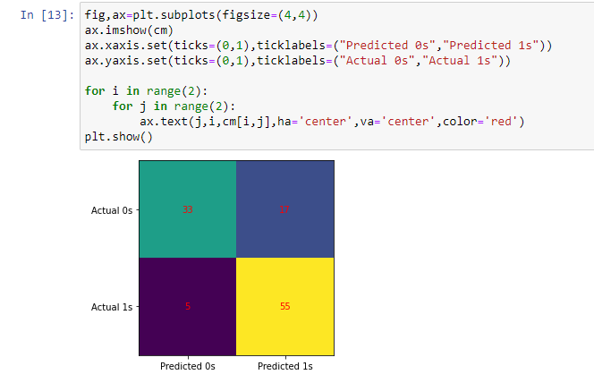
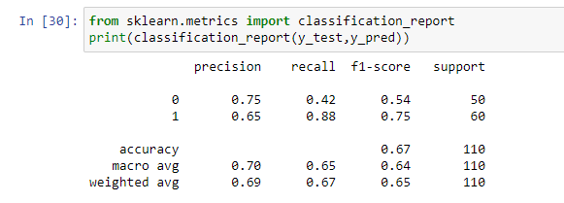
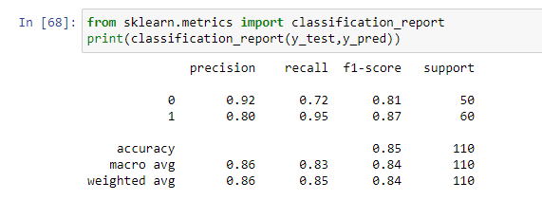
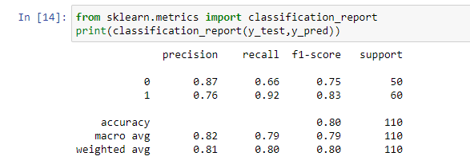
Task 4
MODEL EVALUATION
Using Confusion Matrix → to find the performance measure (False Positive / Negative)
SVM
RANDOM FOREST
MLP
Accuracy of 67% False positive (29%) False negative (7%) | Accuracy of 83% False positive (16%) False negative (2%) | Accuracy of 80% False positive (17%) False negative (5%)

Slide 9
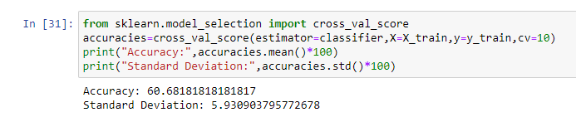
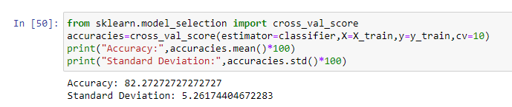

Task 5
IMPROVE THE PERFORMANCE
1) CROSS VALIDATION
SVM
Accuracy: 60%
RANDOM FOREST
Accuracy: 82%
MLP
Accuracy: 75%

Slide 10
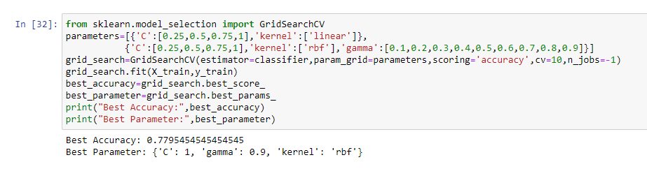
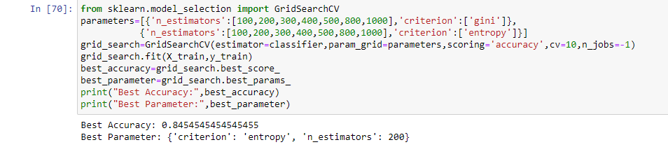
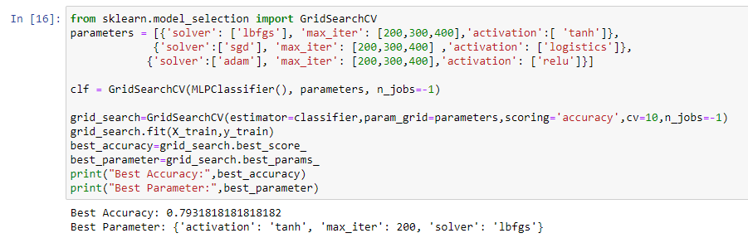
Task 5
IMPROVE THE PERFORMANCE
2) GRID SEARCH
SVM
Best Accuracy: 77%
RANDOM FOREST
Best Accuracy: 84%
MLP
Best Accuracy: 79%

Slide 11

Final result
RANDOM FOREST
CONCLUSION:
Random Forest is chosen as a Final Model
E-commerce - recommended platform to sell these products online

Slide 12

Thank You

